Slide 1


Retaining Value: Segment-Based Predictive Models for Customer Churn in Banking
Leveraging Microsoft Azure ML for Customer Retention
by Priyal Rawat, Abhishek Sharma & Dr. Itauma Itauma
Northwood University, DeVos Graduate School
IBAC 2025, SUNY Fredonia (May 8–9, 2025)

Slide 2

Problem Statement
1
Critical Challenge
2
Manual Monitoring
Customer churn affects revenue, and retention reduces costs compared to customer acquisition. Crucial for banking profitability.
Difficult to predict churn in time.
3
Segment Gap
4
Research Goal
Most churn models assume uniform customers; HNW and Regular behave differently.
Develop interpretable, segment-aware, cost-sensitive models to score churn risk.
Microsoft Azure ML for Customer
Retention

Slide 3
Literature Review
Churn Drivers
Challenges in Prediction
ML Techniques & Gaps Addressed
Service fees, poor customer experience, and availability of alternatives are key drivers of customer churn. (Datrics AI, 2023)
Retaining existing customers costs far less than acquiring new ones, making churn prediction a strategic priority in banking (Singh & Anik, 2023; Datrics AI, 2023).
Rule-based and manual monitoring systems are reactive and don’t scale, often predicting churn only after it occurs (Michael, 2024; Tran, 2023).
Logistic Regression offers simplicity & transparency. (Hoang Tran, 2023)
Ensemble models like Random Forest and Gradient Boosting improve predictive accuracy but lack transparency, hindering stakeholder trust (Malit, 2018; Papierski, 2023).

Slide 4

Methodology
Dataset & Segmentation
Model Types
Bank Customer Churn Dataset (Kaggle). HNW defined as ≥$100k salary; Regular under $100k.
Logistic Regression
Decision Tree
Random Forest
Gradient Boosting
Cost-Sensitive Learning
Outcome
Class weights set: 0 (non-churn) = 1, 1 (churn) = 3 for balanced cost awareness.
Churn risk scoring system categorizing customers as High, Medium, or Low risk

Slide 5
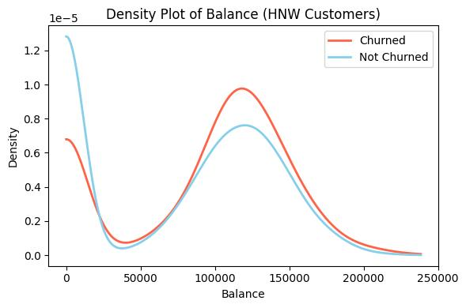
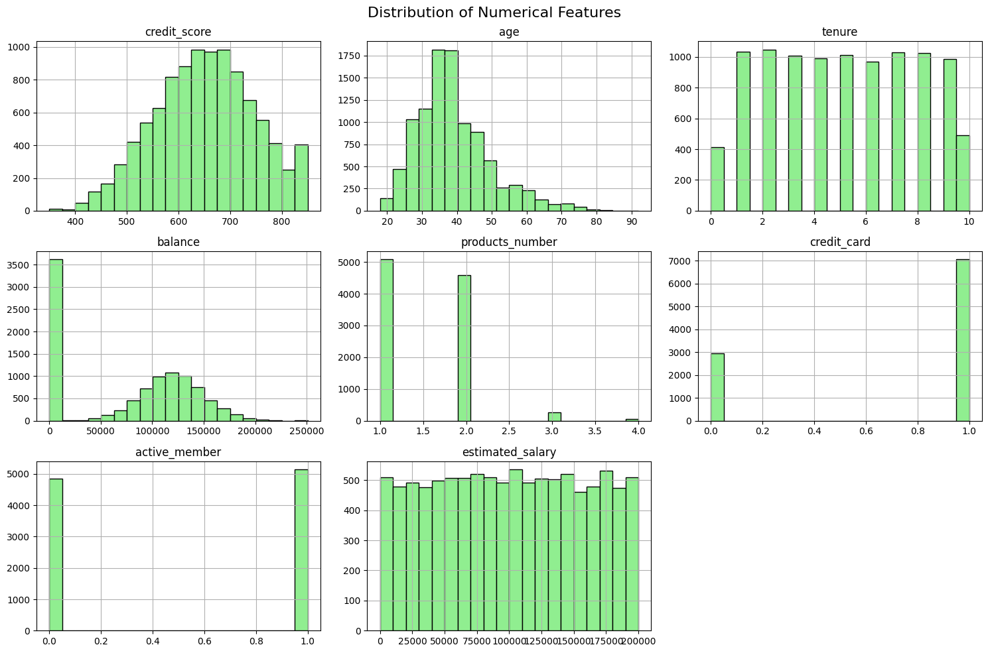
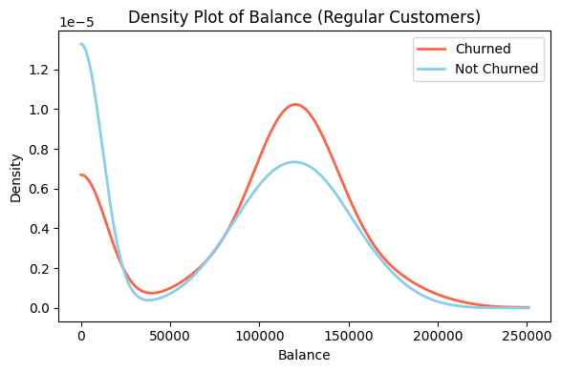
Exploratory Data Analysis (EDA)
Churn Rates
Key Drivers Identified
Overall churn about 20%. HNW churn slightly higher at 21% than Regular at 19.5%.
Tenure less than 3 years, single product usage, female customers exhibit higher churn.

Slide 6
Model Performance Comparison
High Net Worth Customers
Regular Customers
Model
Accuracy
Precision
Recall
F1 Score
Model
Accuracy
Precision
Recall
F1 Score
Random Forest
0.857
0.75
0.389
0.512
Gradient Boosting
0.848
0.731
0.391
0.51
Gradient Boosting
0.852
0.727
0.373
0.493
Random Forest
0.846
0.731
0.376
0.497
Logistic Regression
0.807
0.5
0.15
0.231
Logistic Regression
0.818
0.661
0.203
0.311
Decision Tree
0.791
0.459
0.466
0.463
Decision Tree
0.791
0.482
0.461
0.471
Best Model: Random Forest with F1 Score 0.512
Best Model: Gradient Boosting with F1 Score 0.510

Slide 7
Cost-Sensitive Model Performance
To address statistical imbalance and misclassification issue, we applied cost sensitive learning to churned category.
Segment
Model
Precision (Churn Class)
Recall (Churn Class)
F1 Score (Churn Class)
Accuracy
High Net Worth
Random Forest
0.71
0.34
0.46
0.85
Regular
Gradient Boosting
0.49
0.69
0.57
0.79
Cost-sensitive tuning improves detection of churners without high false positives.

Slide 8
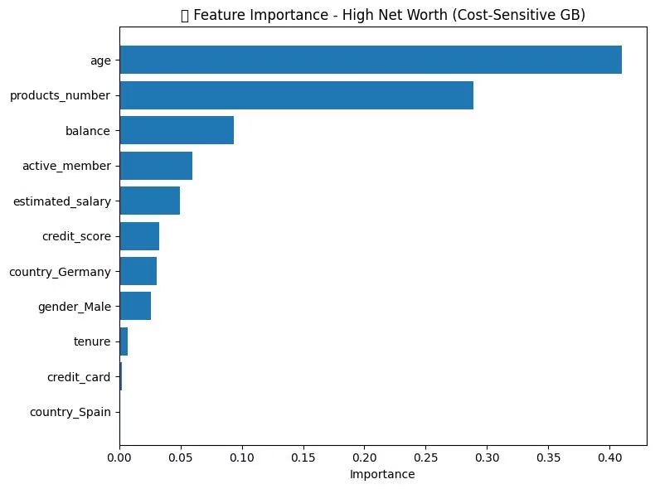
Feature Importance by Segment (HNW)
HNW Segment
Age, product number, account balance
and active membership drive churn risk.

Slide 9
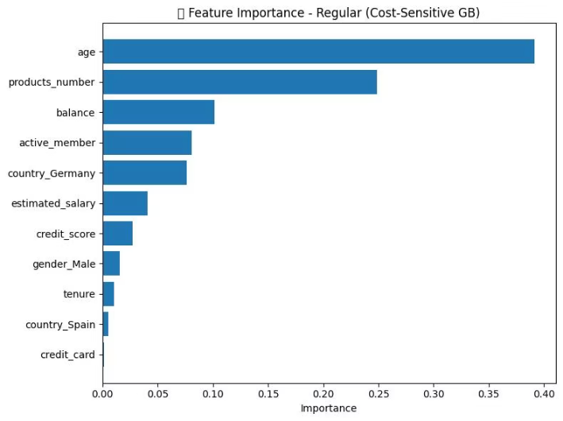
Feature Importance by Segment (Regular)
Regular Segment
Age, product count, and balance are most influential features.

Slide 10
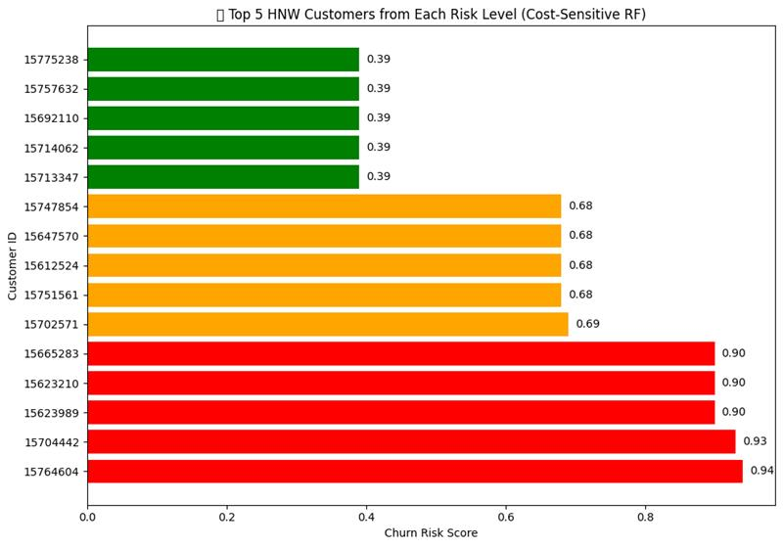
Churn Risk Score
Scoring Tiers
High risk ≥0.70, Medium 0.40–0.69, Low below 0.40 scores.

Slide 11
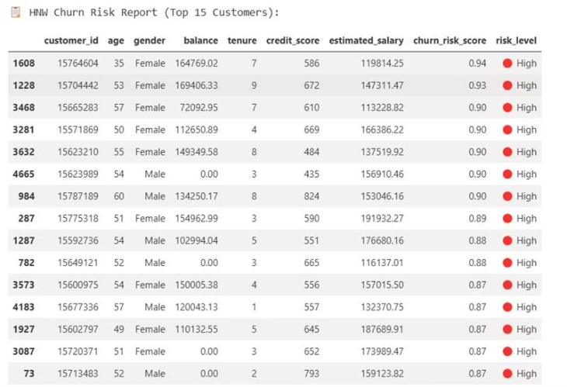
Churn Risk Scoring System
Operational Use
Risk reports integrate with CRM for actionable insights by managers.

Slide 12

Key Takeaways
Segmented Modeling
Increases predictive accuracy and aligns with customer behavior nuances.
Cost-Sensitive Tuning
Enhances detection of valuable churn cases, balancing false positives in the Regular Segment
Operationalization
Model output fits seamlessly into CRM dashboards for real-time management.

Slide 13
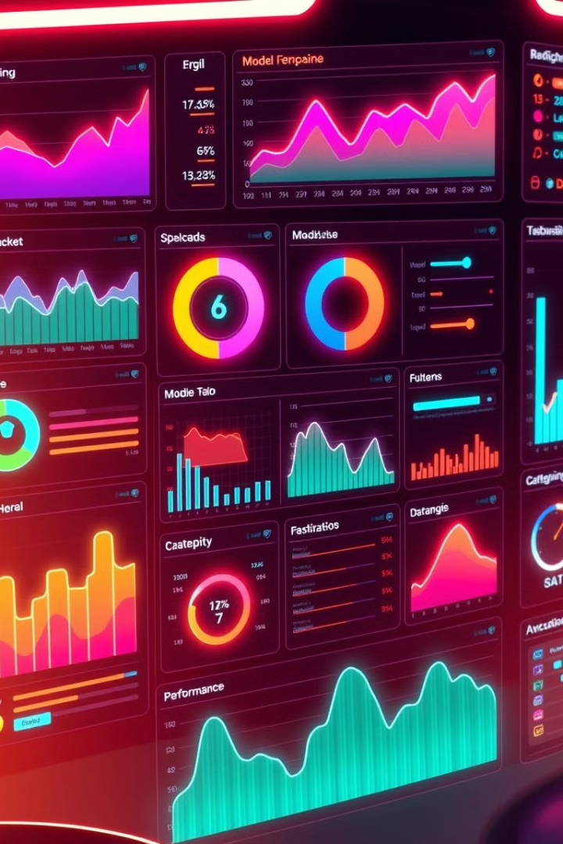



Limitations
Operational Dependencies
The scoring system assumes seamless CRM and
data-pipeline integration; any lag or downtime in those systems can delay risk identification and reduce intervention effectiveness.
Model Drift
Customer behaviors and market conditions evolve, so model performance can degrade without continuous monitoring and retraining.
Segment Maintenance
Refining and updating HNW vs. Regular segmentation criteria (e.g., changing income thresholds) requires governance to avoid inconsistent risk assignments.

Slide 14

Future Work
Add Real-Time Behaviors
Use live transaction and app‐usage data to catch churn signs earlier
Build Retention Models
Predict which retention offers will actually prevent churn for each customer
Notes:
“Looking ahead, we plan three key enhancements. One, integrate real-time behavioral data—such as mobile app logins and transaction frequency—to detect churn signals even earlier. Two, develop uplift models that predict which specific retention offers will actually influence customer behavior, moving from association to causal intervention. And three, implement automated threshold optimization—using rolling performance windows to dynamically adjust risk-tier cutoffs, ensuring our scoring system remains calibrated as customer patterns shift.”

Slide 15




Conclusion
ML Models
Service Personalization
Churn Risk Scoring System
Introduced a replicable, interpretable, segment-aware churn framework
Balanced predictive performance with operational utility
Focus on service personalization.
Enabled proactive retention via churn risk scoring
Notes:
To summarize, we have looked at developing a practical end to end segment based model to predict customer churn. By combining our models, cost sensitive learning and interpretable feature insights, we deliver a risk scoring system ready for operational integration. This approach can be a game changer for relationship manager managing a particular client and for the bank as well, as they can proactively provide resolution to the clients who are about to churn. If implemented correctly, it can provide personalized solution, better service to the client which would never make them to leave the bank.

Slide 16
References
Brito, J. B. G. (2024). A framework to improve churn prediction performance in retail banking. Financial Innovation, 10(1). https://doi.org/10.1186/s40854-023-00558-3
Datrics AI. (2023). Bank churn prediction using ML to retain customers. https://www.datrics.ai/articles/bank-churn-prediction-using-ml-to-retain-customers
Lemos, R. A. de L., Silva, T. C., & Tabak, B. M. (2022). Propension to customer churn in a financial institution: A machine learning approach. Soft Computing, 27(7), 4641–4655. https://doi.org/10.1007/s00521-022-07067-x
Malit, K. (2018). Bank customer churn prediction [Kaggle notebook]. Kaggle. https://www.kaggle.com/code/kmalit/bank-customer-churn-prediction
Michael. (2024). Bank customer churn prediction using machine learning. Analytics Vidhya. https://www.analyticsvidhya.com/blog/2022/09/bank-customer-churn-prediction-using-machine-learning/
Papierski, D. (2023). Investigating customer churn in the banking industry. Medium. https://medium.com/@dpapcodes/investigating-why-customers-leave-a-bank-47b41278e36c
Peng, K., & Peng, Y. (2023). Research on customer churn prediction and model interpretability analysis. PLOS ONE, 18(8), e0289724. https://doi.org/10.1371/journal.pone.0289724
Salesforce. (n.d.). Use the retail banking customer churn prediction dashboards. Salesforce Help. https://help.salesforce.com/s/articleView?id=ind.fsc_use_churn_prediction_retail_banking_dashboard.htm&type=5
Singh, P. P., & Anik, F. I. (2023). Investigating customer churn in banking: A machine learning approach and visualization app for data science and management. Digital Business, 3(3). https://www.sciencedirect.com/science/article/pii/S2666764923000401
Tran, H. (2023). Customer churn prediction in the banking sector using machine learning-based classification models. Interdisciplinary Journal of Information, Knowledge, and Management, 18, 87–105. https://www.informingscience.org/Publications/5086
Generative Pre-trained Transformer (ChatGpt): For Model Coding

Slide 17



Thank You!
Engage
Questions
Discussion
We appreciate your attention!
Now, I welcome your questions.
Let's discuss further.

